Slide 1
Accounting for Interactive Effects:
Assessing the Cost-Effectiveness of Integrated Distributed Energy Resources
Presented at the 2021 National Conference on Energy Efficiency as a Resource
October 27, 2021
Courtney Lane

Slide 2
Synapse Energy Economics
Founded in 1996 by CEO Bruce Biewald
Leader for public interest and government clients in providing rigorous analysis of the electric power sector
Staff of 40 includes experts in energy and environmental economics and environmental compliance
Assists clients with analyzing costs, energy savings, avoided costs, cost-effectiveness, potential studies, rate and bill impacts, price suppression effects, economic and job impacts, and the regulatory policies used to promote and support distributed energy resources.
Lane-8C

Slide 3
Presentation Outline
Overview of the “National Standards Practice Manual for Benefit-Cost Analysis of Distributed Energy Resources” (NSPM for DERS)
Summary of NSPM for DERs guidance on interactive effects
Preview of forthcoming resources
Lane-8C

Slide 4
Overview of the NSPM for DERs

Slide 5

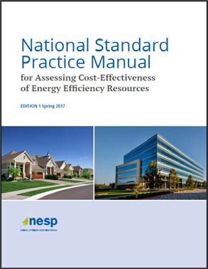
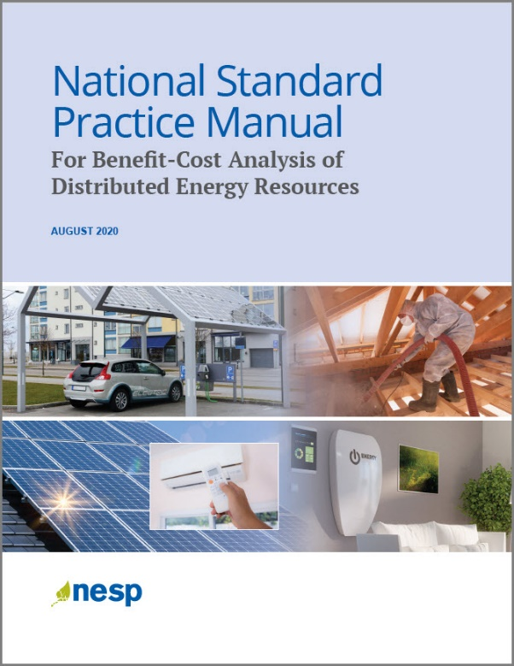
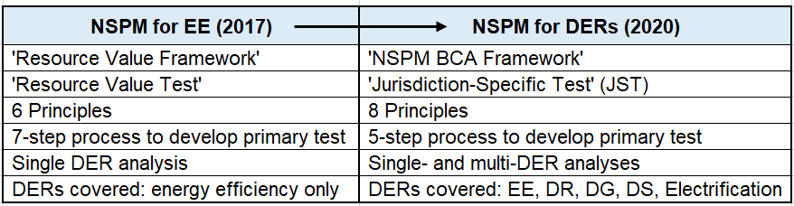
NSPM for EE
May 2017
NSPM for DERs
August 2020
Lane-8C

Slide 6
Audience and Uses
Audience: All entities overseeing/guiding DER decisions (Public utility commissions, state energy offices, utilities, DER reps, evaluators, consumer advocates, and others)
Purpose: Guidance for valuing DER opportunities to inform policies and strategies that support state goals/objectives, such as:
expanding EE/DR plans, strategies, and programs to a broader set of DERs;
evaluating and planning for non-wires/pipes solutions;
incorporating DERs into distribution system planning;
achieving electrification goals, including EV goals;
achieving environmental and carbon emission objectives.
  Applies to:
Programs: initiatives and policies implemented by utilities or other entities to encourage adoption of DERs
Procurements: initiatives to procure DERs, whether built by a utility or procured from third-party vendors, e.g., competitive procurement
Pricing Mechanisms: such as those designed to compensate DERs for their value to grid or to achieve other policy objectives (e.g., time-of-use rates, peak time rebates, critical peak pricing)
Lane-8C

Slide 7
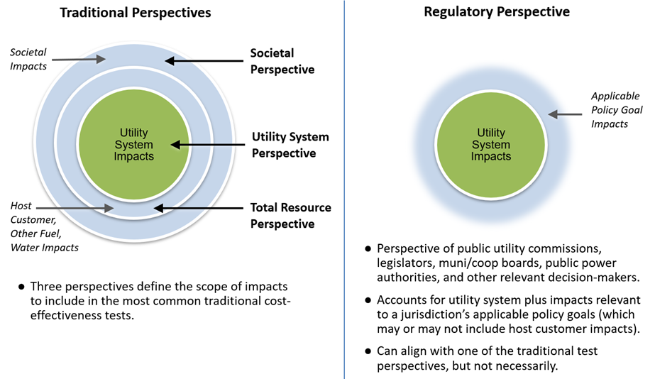
NSPM for DERs: Cost-Effectiveness Perspective
Lane-8C

Slide 8
NSPM for DERs: Principles
1. Recognize that EE and other DERs can provide energy or power system needs, and therefore should be compared with other energy resources and treated consistently for benefit-cost analyses.
2. Align primary test with applicable policy goals.
2. Ensure symmetry across costs and benefits.
3. Account for all relevant, material impacts (based on applicable policies), even if hard to quantify.
4. Conduct a forward-looking, long-term analysis that captures incremental impacts of the DER investment.
5. Avoid double-counting through clearly defined impacts.
6. Ensure transparency in presenting the analysis and the results.
7. Conduct BCA separate from Rate Impact Analyses because they answer different questions.
Lane-8C

Slide 9
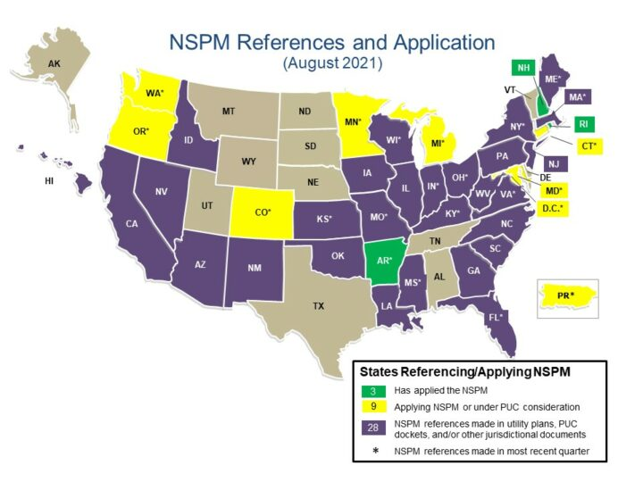
NSPM References and Application
Source: The National Energy Screening Project (NESP)
Lane-8C

Slide 10
NSPM for DERs: Contents
Executive Summary
Introduction
Part I: BCA Framework
Principles
Developing BCA Tests
Part II: DER Benefits and Costs
DER Benefits and Costs
Cross-Cutting Issues
Part III: BCA for Specific DERs
Energy Efficiency
Demand Response
Distributed Generation
Distributed Storage
Electrification
Part IV: BCA for Multiple DERs
Multiple On-Site DERs
Non-Wires Solutions
System-Wide DER Portfolios
Dynamic System Planning
Appendices
Rate Impacts
Template NSPM Tables
Approaches to Quantifying Impacts
Presenting BCA Results
Traditional Cost-Effectiveness Tests
Transfer Payments
Discount Rates
Additional EE Guidance
Lane-8C

Slide 11
NSPM for DERs: Multi-DER Chapters
Chapters:
Content in each Chapter:
Multiple on-site DER types:
such as grid-integrated efficient buildings (GEBs)
Non-Wires solutions (NWS): multiple DER types in a specific geographic location
System-Wide DER Portfolios: multiple DER types across a
utility service territory
Dynamic system planning: practices that can be used to optimize DERs and alternative resources (IDP, IRP)
Summary of key points
Description of how the multiple DER types might be used together
Discussion of key factors in determining benefits and costs for each approach
Guidance on how to address common challenges in determining benefits and costs in multi-DER use cases
Lane-8C

Slide 12
NSPM for DERs:
Guidance on Interactive Effects

Slide 13
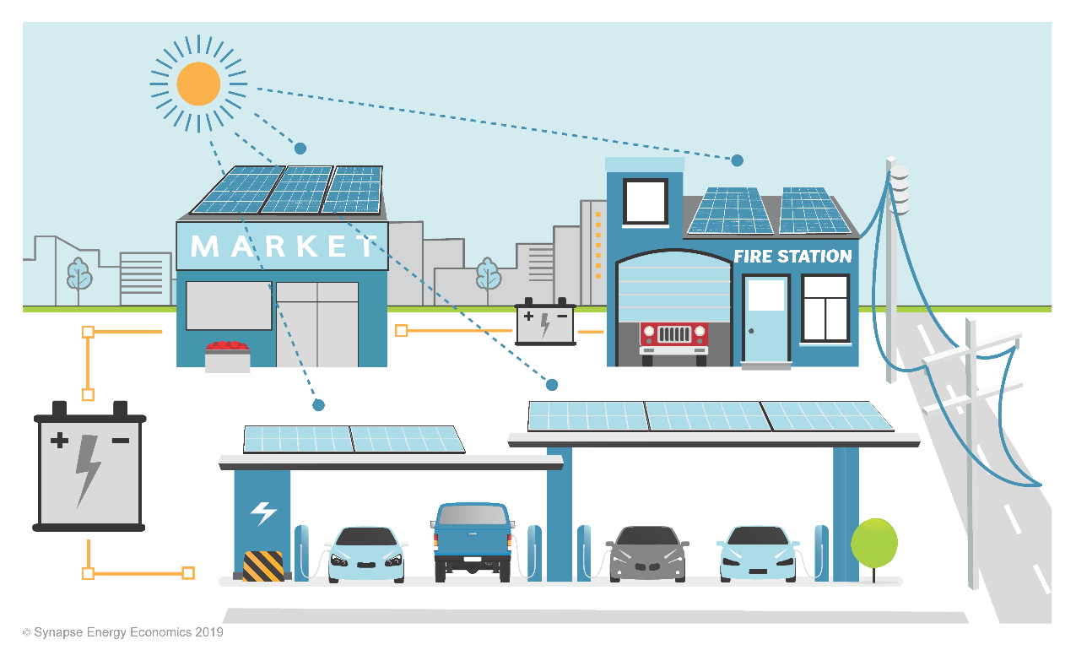
Multiple On-site DERs
Emerging focus across multiple sectors
  Residential and commercial: adoption of multiple DERs, grid-interactive efficient buildings (GEBs)
  Community: microgrids, smart neighborhoods
  Utility System: non-wires solutions (NWS)
Integration of multiple DERs presents a new and unique challenge for regulators seeking to assess cost-effectiveness
  Can require an assessment across multiple utility programs
  Data granularity may not be available
  Requires consideration of specific locational and temporal impacts, who owns/operates DERs, interactive effects between DERs
Lane-8C

Slide 14
Common Types of Interactive Effects
  Avoided Costs
    DERs in one region affect avoided costs of other DERs in that same region
  Energy and Capacity
    One DER affects kWh or kW impacts of other DERs
  Enabling Effects
    One DER makes it easier or more cost-effective to adopt other DERs
Lane-8C

Slide 15
Interactive Effects: Avoided Costs
Typically occurs only when DER penetration is high
For example:
  EE lowers the marginal cost of energy, resulting in reduced avoided energy costs for other DERs
  Shifts in peak demand from increased solar deployment impact the avoided capacity costs of high efficiency air conditioning measures
Lane-8C

Slide 16
NSPM Guidance:
Interactive Effects - Marginal Costs
System planning approach
  States with Integrated Resource Plans, Integrated Distribution Planning, or Integrated Grid Planning should incorporate DER load impacts into system planning to consider both DER and supply-side solutions.
Alternative approaches
  Use a least cost approach: assume least cost resources are implemented first – then determine avoided costs for additional DERs.
  Modify avoided costs over time: later years of study can assume a certain amount of DERs are installed in earlier years.
  Employ scenarios: use different assumptions for avoided costs under different scenarios. One scenario assesses the BCA of DERs without modifications to the avoided costs. The next scenario uses modified avoided costs that assume a certain set of DERs are installed.
Lane-8C

Slide 17
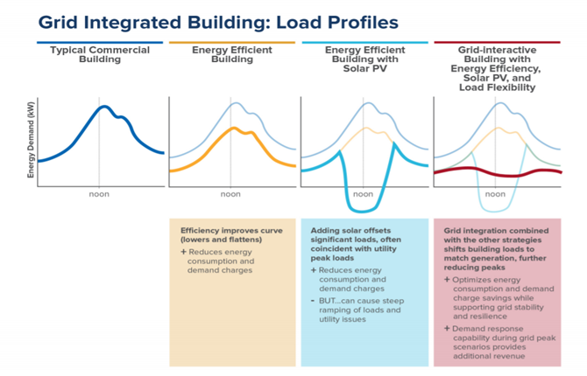
Interactive Effects: Energy and Capacity
Common example: Grid-Interactive Efficient Buildings (GEB)
Source: RMI 2019
Lane-8C

Slide 18
NSPM Guidance:
Interactive Effects - Energy and Capacity
BCAs should fully capture the net potential interactive effects
Interactive effects can have both a positive and negative impact on BCA
  Increase in benefits: solar plus storage can capture greater benefits when charging and discharging align with system off-peak and peak periods
  Reduction in benefits: EE reduces load but also reduces DR kW potential
EM&V techniques depend on infrastructure, visibility, and controls (e.g., AMI submeters and load disaggregation)
A bottom-up approach can also be used
  Determine load reduction and avoided costs of non-dispatchable resources first (EE, solar)
  Remaining load from dispatchable resources (DR, storage) assessed second
Lane-8C

Slide 19
Interactive Effects: Enabling Effects
Examples
  Storage can improve the cost-effectiveness of distributed solar through price arbitrage.
  Commercial lighting with controls can enable future demand response.
NSPM Guidance
  Combined BCA Approach
    Estimate the probability of the second DER type being installed.
    Forecast the expected impact of interactive effects.
    Calculate a probability-weighted net impact. Multiply the results of the first two steps to derive a value to include in the cost-effectiveness analysis.
  Separate BCA Approach
    Conduct BCA for each DER separately.
    Account for full costs and benefits of the first DER installed based on standalone capabilities.
    At the time of the second DER installation, only account for incremental cost and incremental benefit.
Lane-8C

Slide 20
Upcoming Projects

Slide 21
Forthcoming: Companion Guidance to the NSPM
Methods, Tools, and Resources (MTR): A Handbook for Benefit-Cost Analysis of DERs
Guidance on how to develop inputs for BCAs
Based on existing and evolving practices and resources for quantifying DER benefits and costs
Will include bibliography of publicly available documents, data sources, and modeling tools that can be used to develop BCA inputs
Funded by E4TheFuture as an NESP publication
  Lead contractors: Synapse (with Energy Futures Group, ACEEE, ICF)
Planned Publication: January 2021
Lane-8C

Slide 22

Forthcoming: NSPM for DERs Benefit-Cost Analysis Case Studies
Objective
Building on the NSPM for DERs, this project aims to map and document critical benefit-cost analysis of selected single and multi-DER technology use cases to:
  Demonstrate application of the NSPM for DERs guidance and key principles
  Further inform jurisdictional understanding and usage of the NSPM for DERs benefit-cost analysis framework.
Scope
SEPA and ICF to develop 3 case studies for E4TheFuture with key objectives including:
Identify illustrative benefit-cost analysis of leading DER use cases (informed by real-world use cases but generalized into hypothetical / illustrative examples)
Demonstrate approaches to accounting for impacts in benefit-cost analysis under different data availability conditions (e.g., primary research/study, use of proxy value/percent adder, qualitative assessment, etc.)
Lane-8C

Slide 23
Forthcoming: NSPM for DERs Benefit-Cost Analysis Case Studies
Case studies:
Residential Retrofit Grid-interactive Efficient Building (GEB) in Mid-Atlantic
Commercial Solar + Storage Controlled Dispatch in West
Residential EV Managed Charging in Midwest
Publication: Early 2022
Lane-8C

Slide 24
Contact
Courtney Lane
Synapse Energy Economics
clane@synapse-energy.com
  Additional Information on NSPM for DERs and supporting Resources:
  http://www.nationalenergyscreeningproject.org/
Lane-8C

